Slide 1


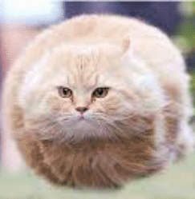


Speeding to glory
Max Curie

Slide 2
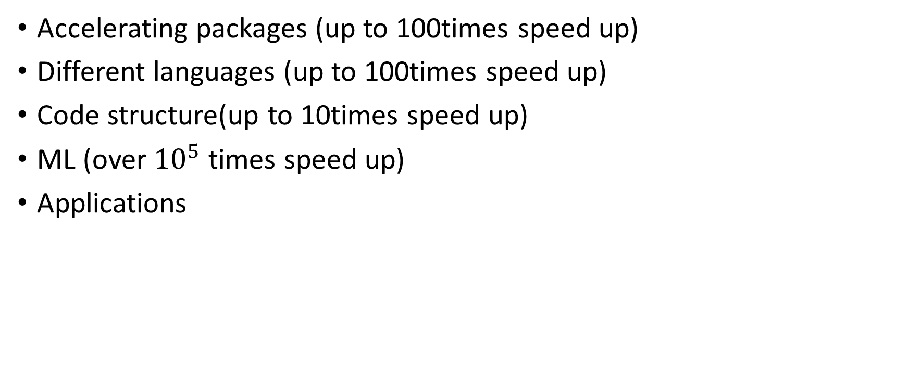
Outline
Accelerating packages (up to 100times speed up)
Different languages (up to 100times speed up)
Code structure(up to 10times speed up)
ML (over ${10}^{5}$ times speed up)
Applications
https://github.com/maxcurie1996/Parallel_programming

Slide 3
Question
Fast way to access the stability of MTM for equilibrium fitting
Before the acceleration it take about 300sec to access one equilibrium
One needs to have a tool to find the frequency and stability in less then 1 sec to be meaningful.

Slide 4
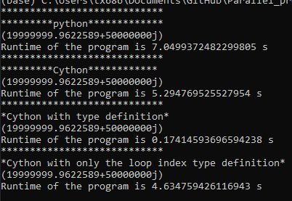
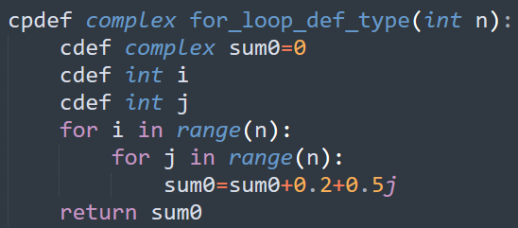
Cython (C in python)
Python regarding everything as object type. It takes significant time to determine the data type.
So, define the data type in Cython will significantly increase the speed of code for the most the time.
tutorial on cython: https://youtu.be/mXuEoqK4bEc

Slide 5
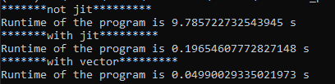
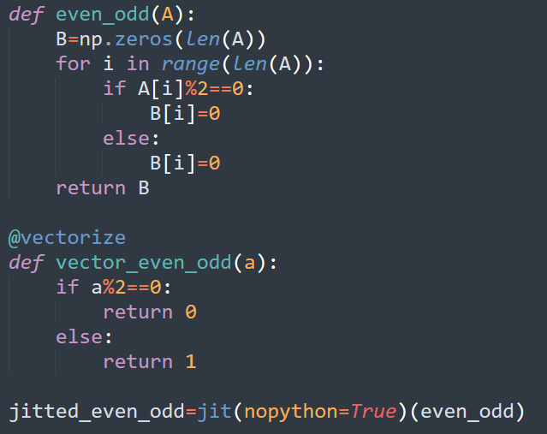
Numba
Vectorize (do action on each element in paradelle)
jit (create a faster machine code)
And more…
https://youtu.be/x58W9A2lnQc

Slide 6

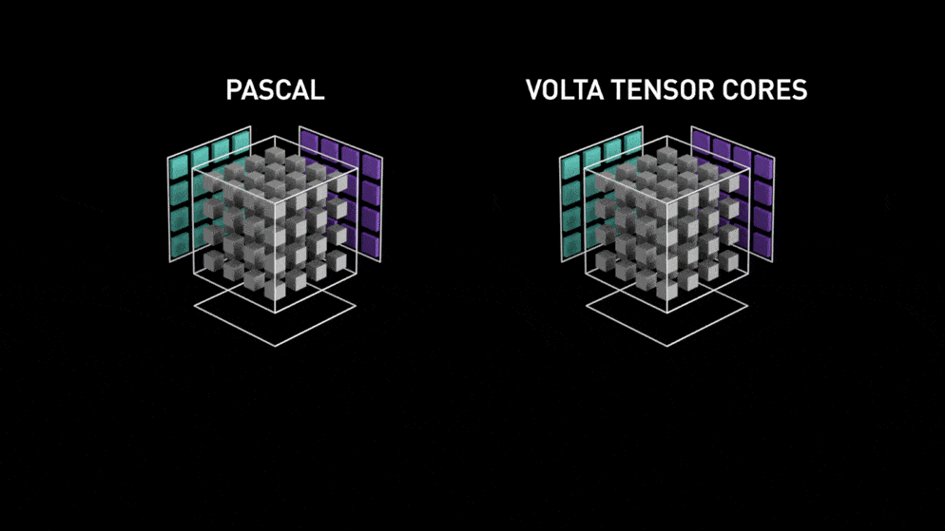
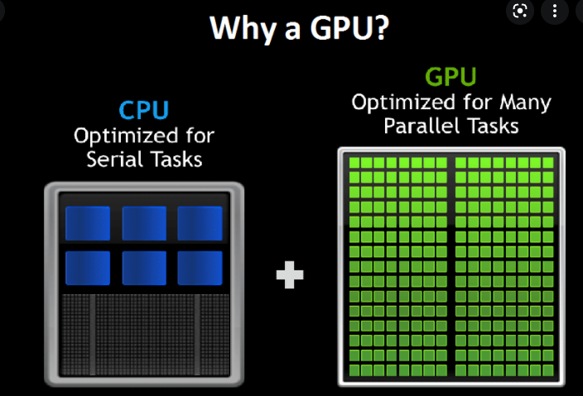
CUDA
CUDA is a package that allows one to run and write code that runs on Nvidia GPU.
tutorial on to install CUDA: https://youtu.be/hHWkvEcDBO0

Slide 7
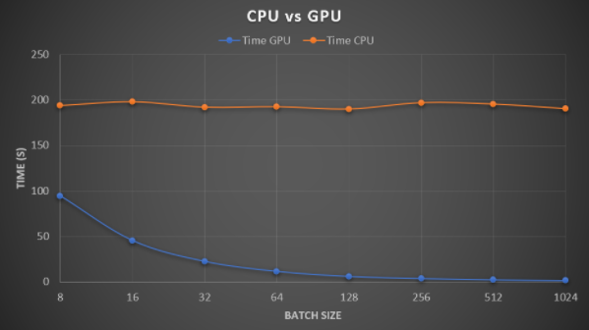
CUDA and cuDNN in Machine learning
It increases the learning rate by over 50 times!

Slide 8
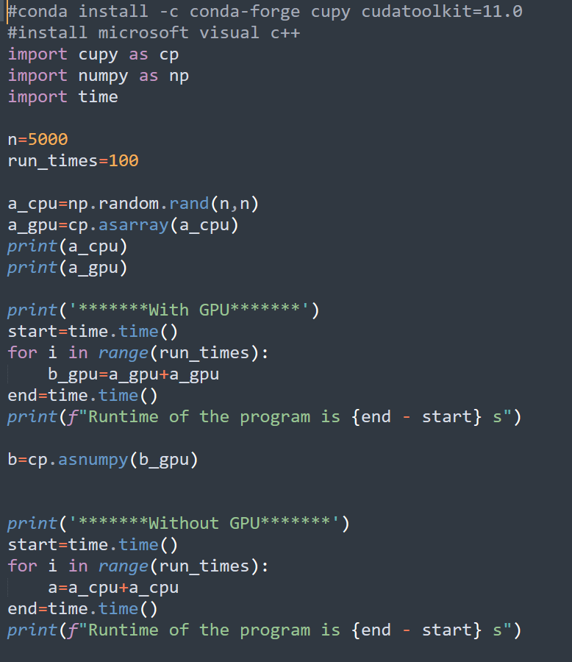
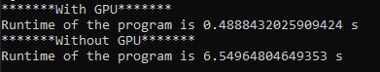
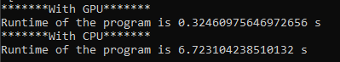
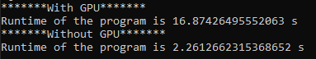
cupy (almost extactly like numpy)
Accelerate matrix calculation X10!
Addition
Multiplication
Inversion

Slide 9
Create you own GPU code.
I don’t know you figure it out. Here is the resource: https://youtu.be/9bBsvpg-Xlk

Slide 10
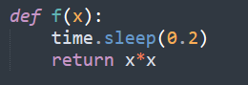
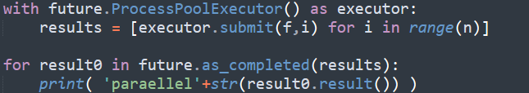
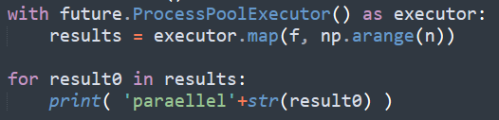
CPU parallel—easiest (concurrent.futures)

Slide 11
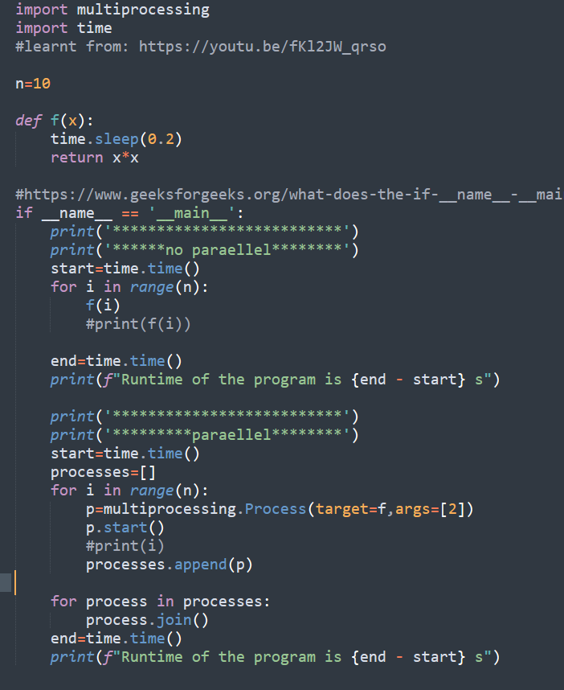
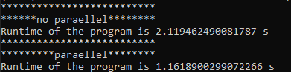
multiprocessing
https://youtu.be/fKl2JW_qrso

Slide 12
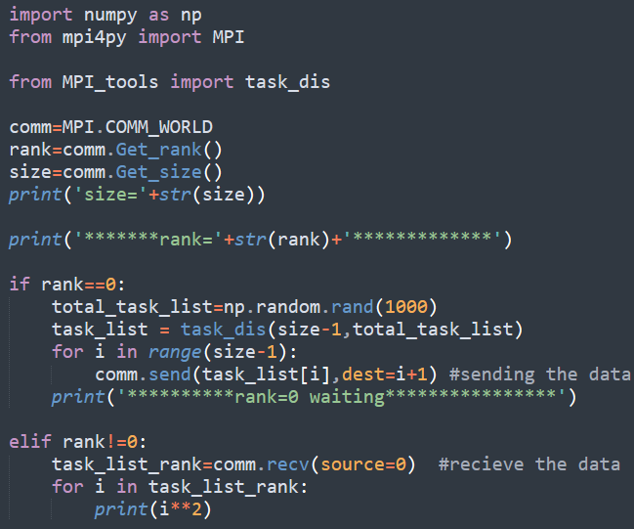
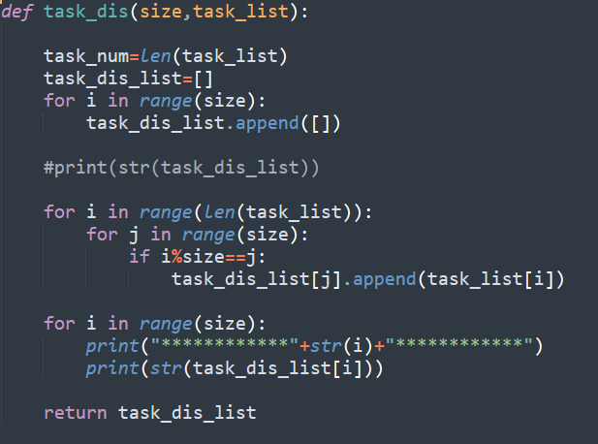
MPI4py -- Python in supercomputer

Slide 13
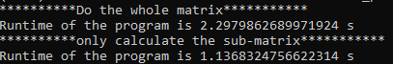
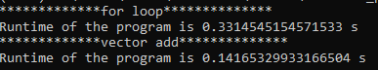
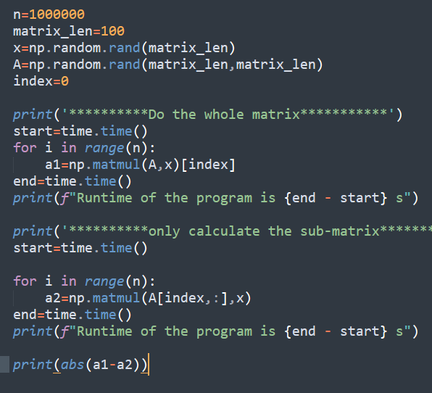
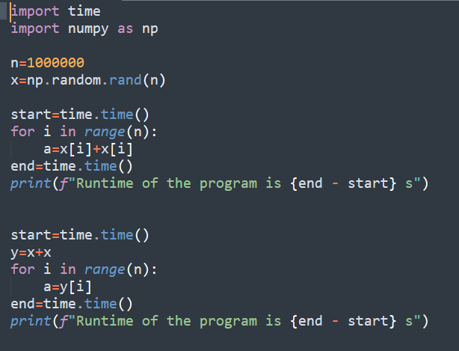
Structure

Slide 14
Summary
Data | Operation | Normal | CPU | GPU | Other | Acceleration | Package | Method | Code | Comment
Matix | add | 6.589378 |  | 0.153785 |  | 42.84813 | cupy |  | ./GPU/python/cupy/Add_Matrix.py
Matix | Inversion | 2.152613 |  | 16.23837 |  | 0.132563 | cupy |  | ./GPU/python/cupy/Inversion_Matrix.py
Matix | multiplication | 6.541572 |  | 0.326043 |  | 20.06355 | cupy |  | ./GPU/python/cupy/Multi_Matrix.py
Matix | add | 10.30245 | 0.163662 |  |  | 62.94948 | numba | Vectorization | ./GPU/python/numba/vector_loop.py
Matix | multiplication | 3.851169 | 4.494436 |  |  | 0.856875 | numba
Matix | multiplication | 0.02834 | 8.830183 |  |  | 0.003209 | numba | Vectorization | ./GPU/python/numba/vectorize_matrix_multi.py
array | add | 0.033909 |  |  | 0.015957 | 2.124966 | numpy | add as vector | ./Structrure/loop_VS_array.py
array | multiplication | 2.037554 |  |  | 1.061193 | 1.920059 | numpy | take_element_of_matrix_operation | ./Structrure/take_element_of_matrix_operation.py

Slide 15
Dataset from CORI simulations
Unstable: 300,000
Stable: 600,000

Slide 16
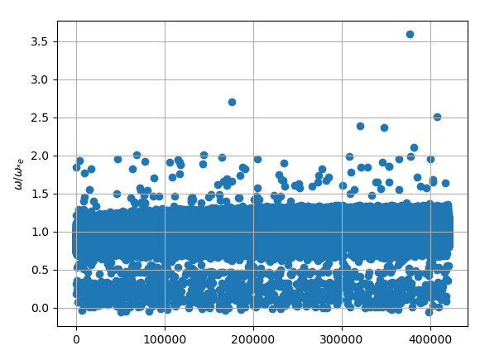

Slide 17
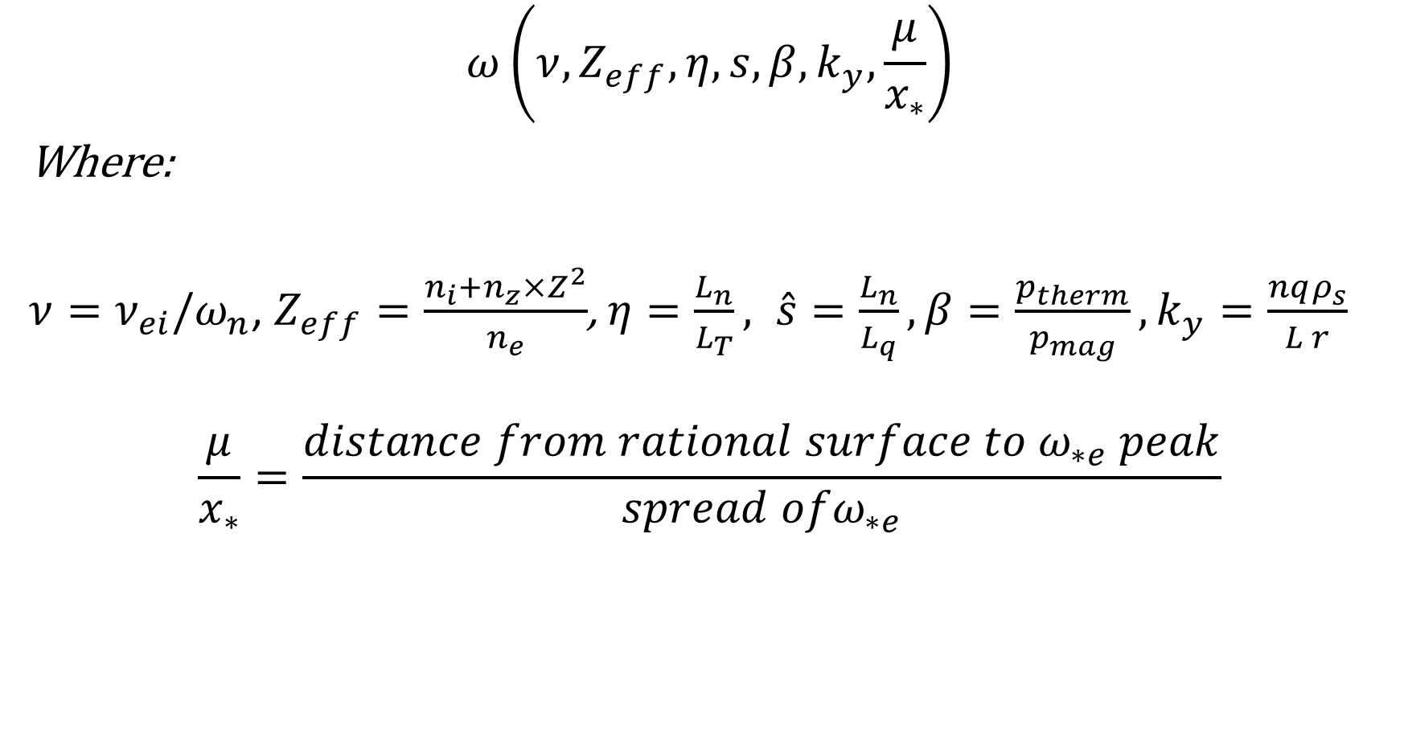
Parameter dependents
$$ω\left(ν,Z_{eff},η,s,β,k_{y},\frac{μ}{x_{∗}}\right)$$
Where:
$ν=ν_{ei}/ω_{n}$, $Z_{eff}=\frac{n_{i}+n_{z}×Z^{2}}{n_{e}}$, $η=\frac{L_{n}}{L_{T}}, \hat{s}=\frac{L_{n}}{L_{q}}, β=\frac{p_{therm}}{p_{mag}}, k_{y}=\frac{nqρ_{s}}{L r}$
$$\frac{μ}{x_{∗}}=\frac{distance from rational surface to ω_{∗e} peak}{spread ofω_{∗e}}$$

Slide 18
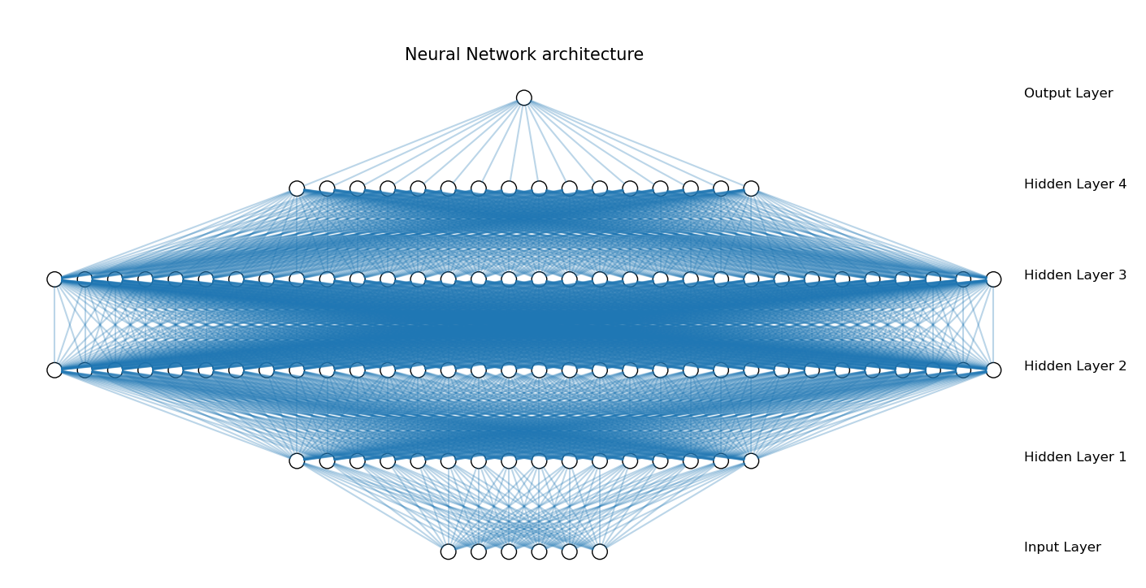
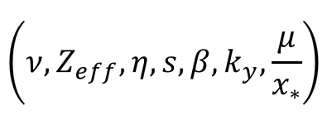
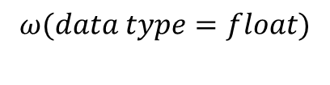
$$ω(data type=float)$$

Slide 19

$$γ(data type=boolean)$$

Slide 20
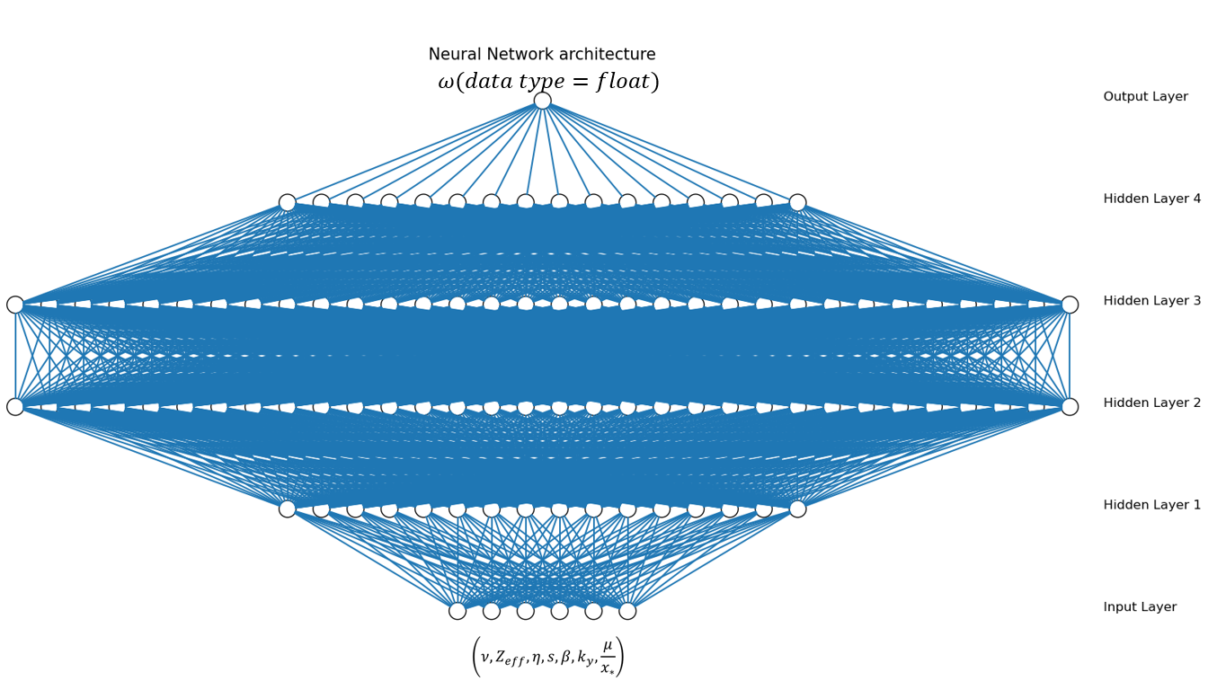
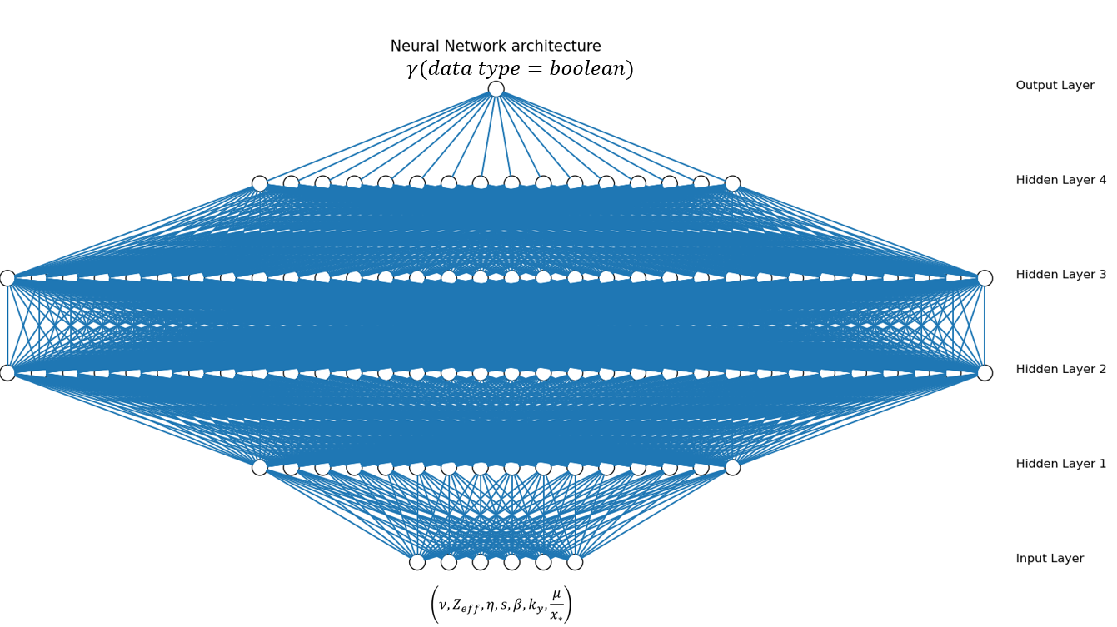

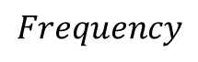
$$Frequency$$
Stable/unstable
$$unstable MTM frequencies$$

Slide 21
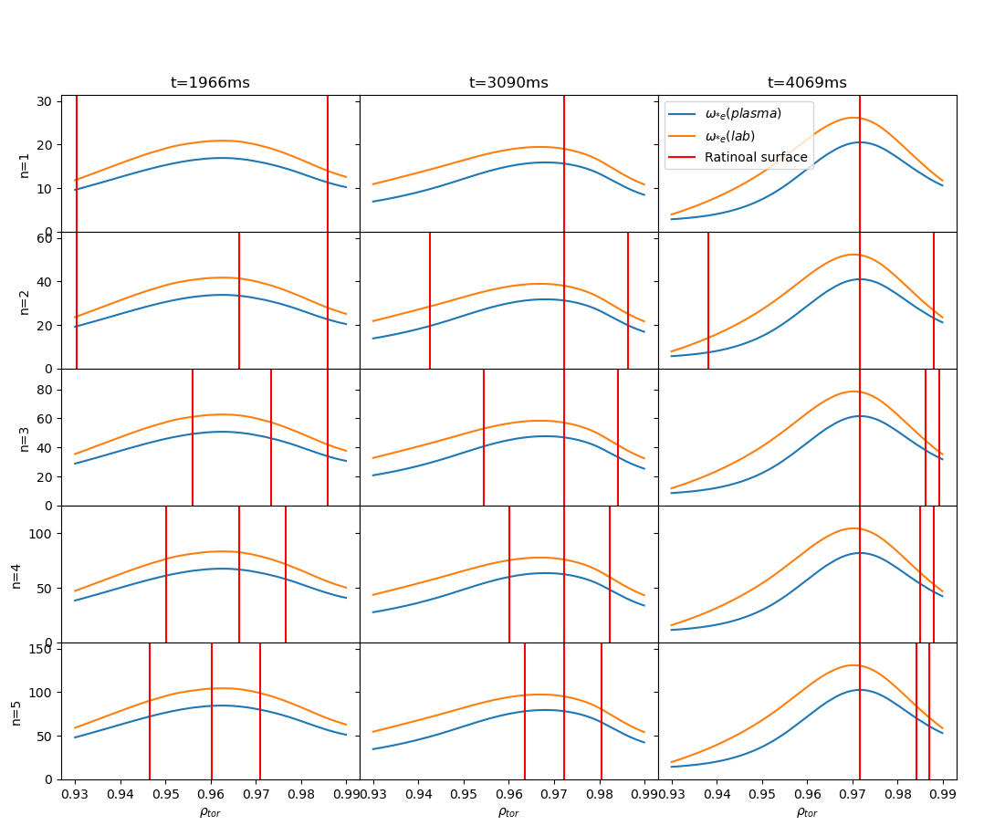
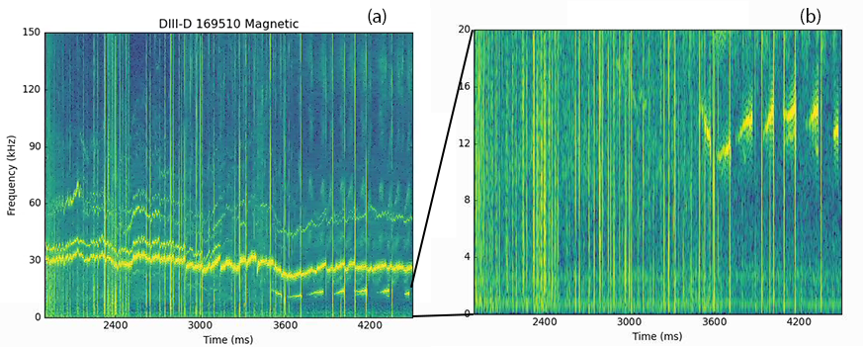
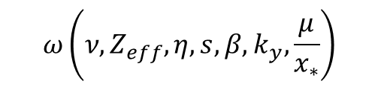
$$ω\left(ν,Z_{eff},η,s,β,k_{y},\frac{μ}{x_{∗}}\right)$$
Vary profile
Match with experiment?
Ideal profile

Slide 22
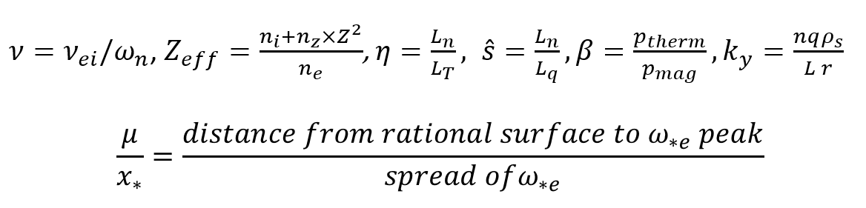
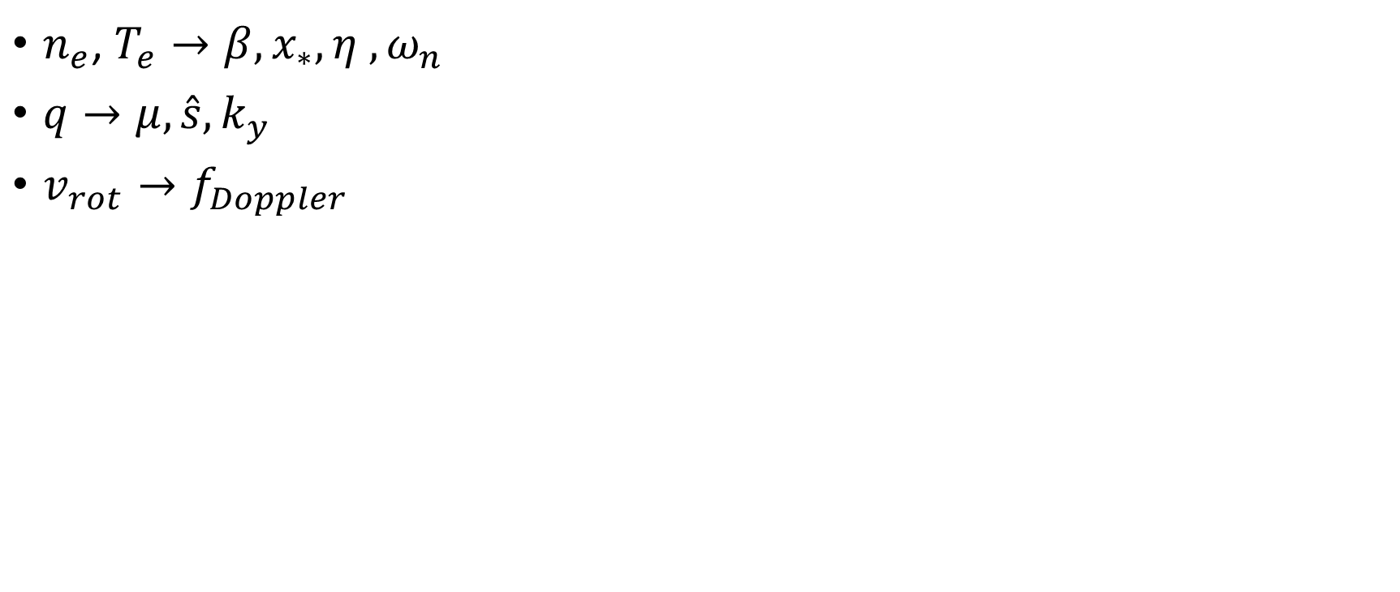
Vary profile
$n_{e}$, $T_{e}→β,x_{∗}, {η ,ω}_{n}$
$q→μ, {\hat{s},k}_{y}$
$v_{rot}→f_{Doppler}$

